Slide 1
Internet Transport Protocol - UDP

Slide 2
UDP
User Datagram Protocol
Connection less
Unreliable
No flow control
No error control
No congestion control

Slide 3
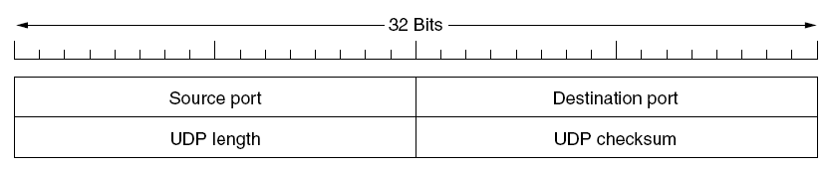
UDP header fields
Source Port
Destination Port
UDP Length
Length of the datagram (header size + payload size)
UDP Checksum

Slide 4
Remote Procedure Call - RPC

Slide 5
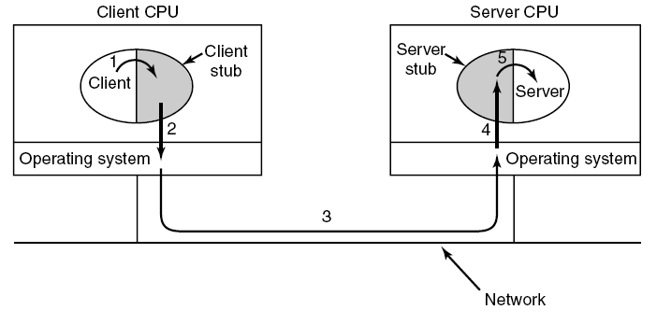
Steps in making a remote procedure call
The idea behind RPC is to make a remote procedure call look as much as possible
like a local one

Slide 6
RPC
Client program must be bound with a small library procedure, called the client stub. It represents the server procedure in the client’s address space
Server is bound with a procedure called the server stub
These procedures hide the fact that the procedure call from the client to the server is not local

Slide 7
Steps in RPC
STEP 1 – client calling the client stub. Parameters pushed onto the stack in the normal way
STEP 2 - client stub packing the parameters (marshaling) into a message and making a system call to send the message
STEP 3 - operating system sending the message from the client machine to the server machine
STEP 4 – operating system passing the incoming packet to the server stub
STEP 5 – server stub calling the server procedure with the unmarshaled parameters
The reply traces the same path in the other direction

